Slide 1
Deep Learning for Biology
Joris Roels

Slide 2
Unsupervised Neural Networks

Slide 3











Overview
Introduction
Autoencoders
Regularizations
Deep K-means clustering
$x_{1}$
${\hat{x}}_{1}$
$h_{1}$
$x_{2}$
${\hat{x}}_{2}$
$h_{2}$
$$…$$
$$…$$
$$…$$
$h_{m}$
$x_{n}$
${\hat{x}}_{n}$

Slide 4
Introduction

Slide 5



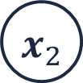









Introduction
So far, we have only considered supervised learning
$x_{1}$
$h_{1}$
${\hat{y}}_{1}$
$y_{1}$
$x_{2}$
$h_{2}$
${\hat{y}}_{2}$
$y_{2}$
Loss
$$…$$
$$…$$
$$…$$
$$…$$
$x_{n}$
$h_{m}$
${\hat{y}}_{l}$
$y_{l}$

Slide 6
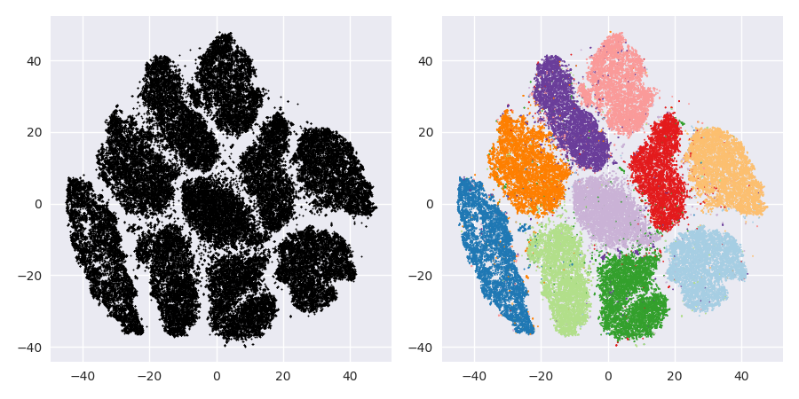
Introduction
What about unsupervised or semi-supervised learning?

Slide 7



Introduction
Labels are sometimes not available or costly
➔ What loss function to use for training?
$x_{1}$
$h_{1}$
${\hat{y}}_{1}$
$y_{1}$
$x_{2}$
$h_{2}$
${\hat{y}}_{2}$
$y_{2}$
Loss
$$…$$
$$…$$
$$…$$
$$…$$
$x_{n}$
$h_{m}$
${\hat{y}}_{l}$
$y_{l}$

Slide 8
Autoencoders

Slide 9


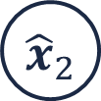

Autoencoder
Special case of an MLP that aims to reconstruct the input
$x_{1}$
$h_{1}$
${\hat{x}}_{1}$
$x_{2}$
$h_{2}$
${\hat{x}}_{2}$
$$…$$
$$…$$
$$…$$
$x_{n}$
$h_{m}$
${\hat{x}}_{n}$

Slide 10

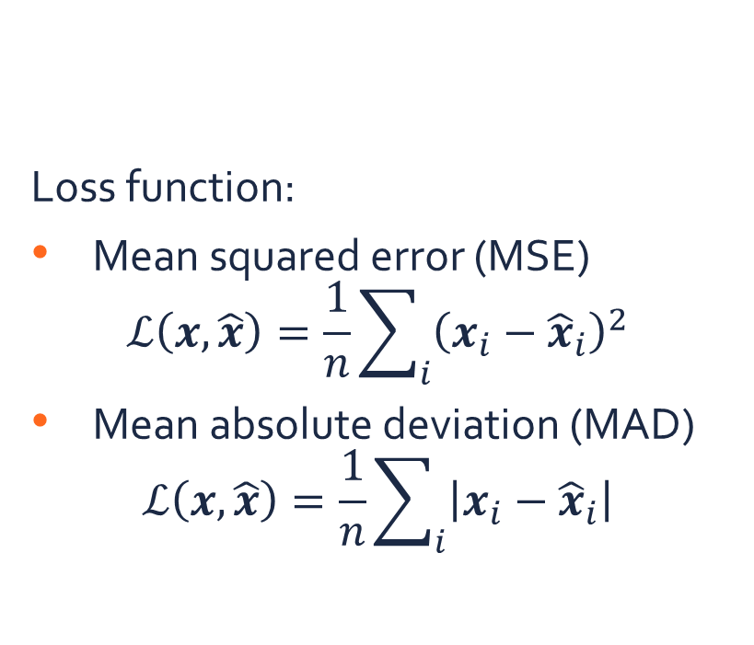


Autoencoder
Loss function:
Mean squared error (MSE)
$$ℒ\left(x,\hat{x}\right)=\frac{1}{n}\sum_{i}{{\left(x_{i}−{\hat{x}}_{i}\right)}^{2}}$$
Mean absolute deviation (MAD)
$$ℒ\left(x,\hat{x}\right)=\frac{1}{n}\sum_{i}{\left|x_{i}−{\hat{x}}_{i}\right|}$$
Special case of an MLP that aims to reconstruct the input
$x_{1}$
$h_{1}$
${\hat{x}}_{1}$
$x_{2}$
$h_{2}$
${\hat{x}}_{2}$
$$…$$
$$…$$
$$…$$
$x_{n}$
$h_{m}$
${\hat{x}}_{n}$

Slide 11
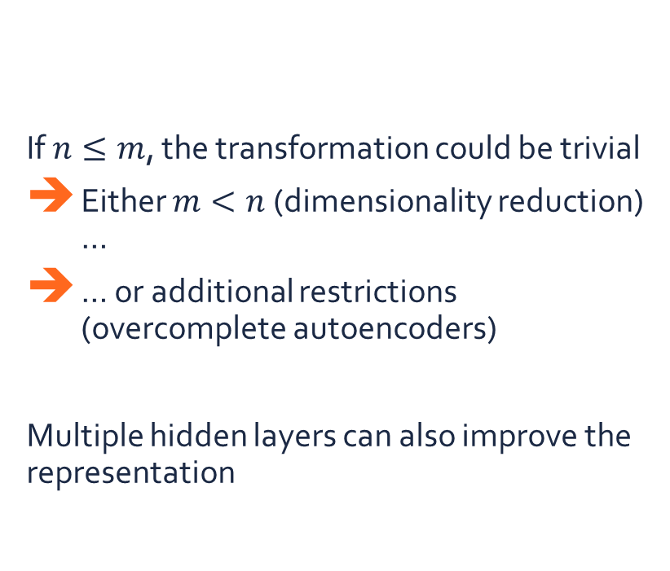
Autoencoder
If $n≤m$, the transformation could be trivial
Either $m<n$ (dimensionality reduction) …
… or additional restrictions (overcomplete autoencoders)
Multiple hidden layers can also improve the representation
Special case of an MLP that aims to reconstruct the input
$x_{1}$
$h_{1}$
${\hat{x}}_{1}$
$x_{2}$
$h_{2}$
${\hat{x}}_{2}$
$$…$$
$$…$$
$$…$$
$x_{n}$
$h_{m}$
${\hat{x}}_{n}$

Slide 12


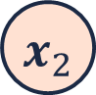






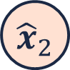


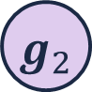





Stacked autoencoder
Extracting hierarchical features by considering the hidden layer as inputs ➔ Train each autoencoder separately after each other
$x_{1}$
${\hat{x}}_{1}$
$h_{1}$
$h_{1}$
${\hat{h}}_{1}$
$g_{1}$
$x_{2}$
${\hat{x}}_{2}$
$h_{2}$
$h_{2}$
${\hat{h}}_{2}$
$g_{2}$
$$…$$
$$…$$
$$…$$
$$…$$
$$…$$
$$…$$
$h_{m}$
$h_{m}$
$g_{l}$
${\hat{h}}_{m}$
$x_{n}$
${\hat{x}}_{n}$

Slide 13





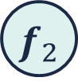






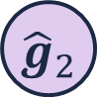



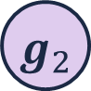

Stacked autoencoder
Extracting hierarchical features by considering the hidden layer as inputs ➔ Train each autoencoder separately after each other
$h_{1}$
${\hat{h}}_{1}$
$g_{1}$
${\hat{g}}_{1}$
$g_{1}$
$f_{1}$
$h_{2}$
${\hat{h}}_{2}$
$g_{2}$
$g_{2}$
$f_{2}$
${\hat{g}}_{2}$
$$…$$
$$…$$
$$…$$
$$…$$
$$…$$
$$…$$
$f_{k}$
$h_{m}$
$g_{l}$
${\hat{h}}_{m}$
$g_{l}$
${\hat{g}}_{l}$

Slide 14
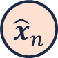
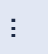


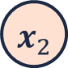

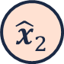

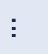



















Stacked autoencoder
Stacking them into each other leads to a hierarchical representation (Lee et.al., 2011)
$x_{1}$
$h_{1}$
${\hat{h}}_{1}$
${\hat{x}}_{1}$
$g_{1}$
${\hat{g}}_{1}$
$f_{1}$
$x_{2}$
${\hat{x}}_{2}$
$h_{2}$
${\hat{g}}_{2}$
${\hat{h}}_{2}$
$g_{2}$
$f_{2}$
$$…$$
$$…$$
$$…$$
$$…$$
$$…$$
$$…$$
$$…$$
$f_{k}$
$h_{m}$
$g_{l}$
${\hat{g}}_{l}$
${\hat{h}}_{m}$
$x_{n}$
${\hat{x}}_{n}$

Slide 15
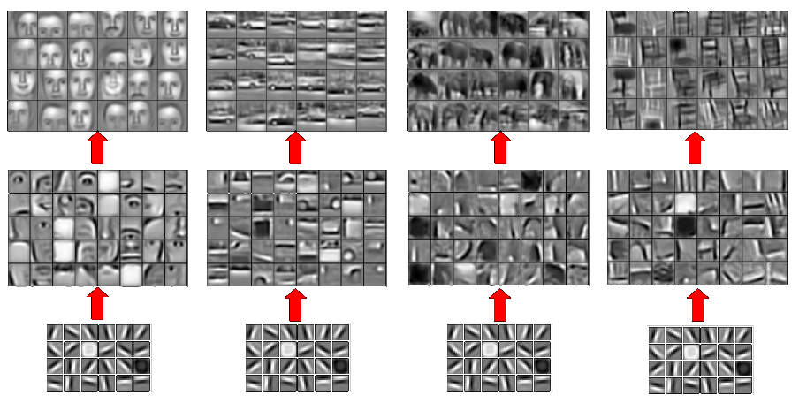



Stacked autoencoder
Stacking them into each other leads to a hierarchical representation (Lee et.al., 2011)
$f_{i}$
$g_{i}$
$h_{i}$

Slide 16
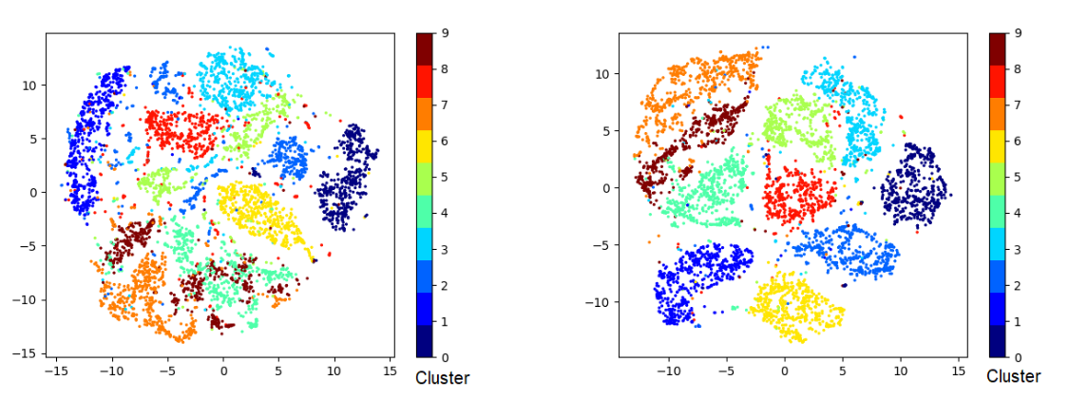




Autoencoder
$x_{1}$
$h_{1}$
${\hat{x}}_{1}$
$x_{2}$
$h_{2}$
${\hat{x}}_{2}$
$$…$$
$$…$$
$$…$$
$x_{n}$
$h_{m}$
${\hat{x}}_{n}$
Apply clustering in the lower-dimensional embedding
Clustering results on the MNIST dataset (t-SNE visualization)
K-means in the input space
K-means in the embedded space

Slide 17
Regularizations

Slide 18

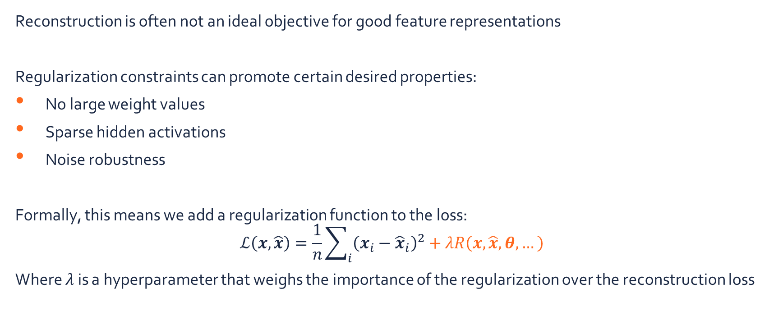


Regularizations
$x_{1}$
$h_{1}$
${\hat{x}}_{1}$
$x_{2}$
$h_{2}$
${\hat{x}}_{2}$
$$…$$
$$…$$
$$…$$
$x_{n}$
$h_{m}$
${\hat{x}}_{n}$
Reconstruction is often not an ideal objective for good feature representations
Regularization constraints can promote certain desired properties:
No large weight values
Sparse hidden activations
Noise robustness
Formally, this means we add a regularization function to the loss:
$$ℒ\left(x,\hat{x}\right)=\frac{1}{n}\sum_{i}{{\left(x_{i}−{\hat{x}}_{i}\right)}^{2}}+λR\left(x,\hat{x},θ,…\right)$$
Where $λ$ is a hyperparameter that weighs the importance of the regularization over the reconstruction loss

Slide 19

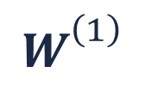


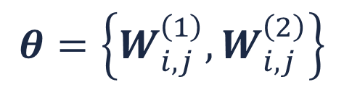
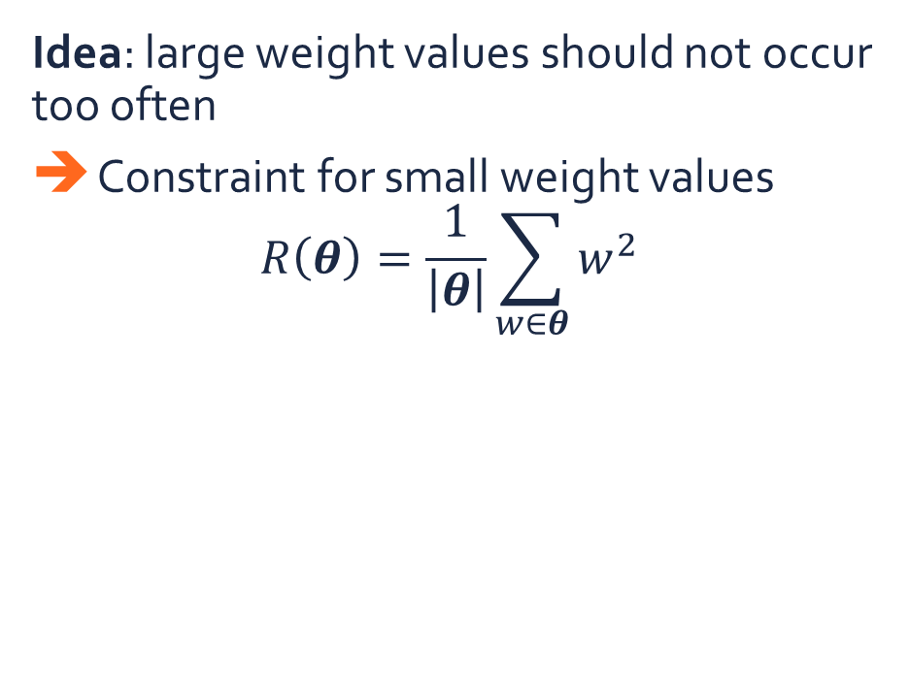





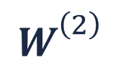
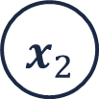

Weight decay
$$θ=\left\{W_{i,j}^{\left(1\right)},W_{i,j}^{\left(2\right)}\right\}$$
Idea: large weight values should not occur too often
Constraint for small weight values
$$R\left(θ\right)=\frac{1}{\left|θ\right|}\sum_{w∈θ}{w^{2}}$$
$$W_{}^{\left(1\right)}$$
$$W_{}^{\left(2\right)}$$
$x_{1}$
${\hat{x}}_{1}$
$h_{1}$
$x_{2}$
${\hat{x}}_{2}$
$h_{2}$
$$…$$
$$…$$
$$…$$
$h_{m}$
$x_{n}$
${\hat{x}}_{n}$

Slide 20
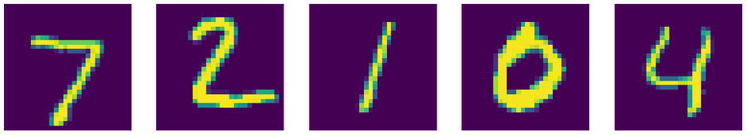
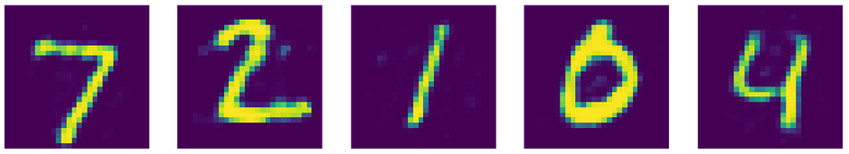
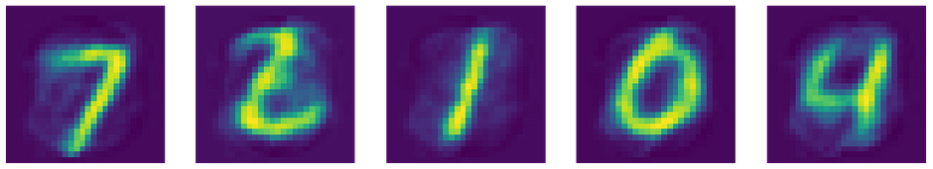
Weight decay
MNIST training samples
Idea: large weight values should not occur too often
Constraint for small weight values
$$R\left(θ\right)=\frac{1}{\left|θ\right|}\sum_{w∈θ}{w^{2}}$$
Reconstructions “vanilla” autoencoder
Reconstructions autoencoder with weight decay

Slide 21
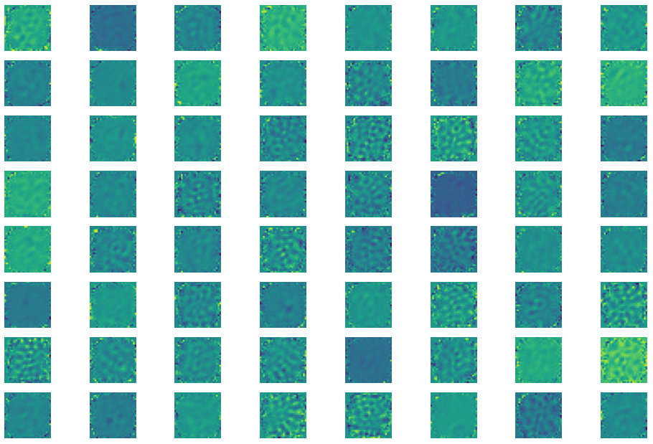
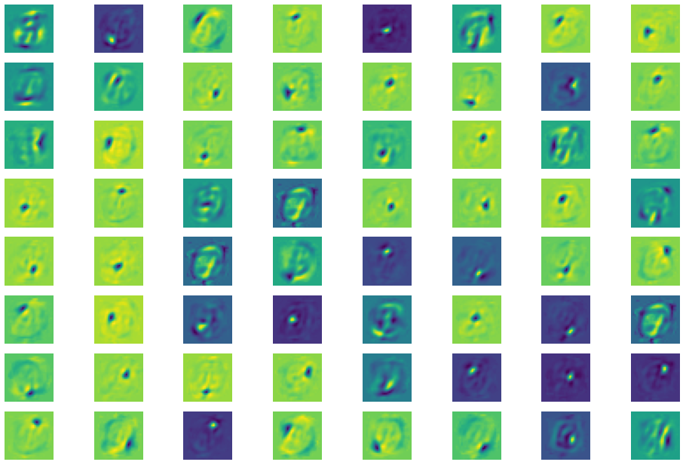
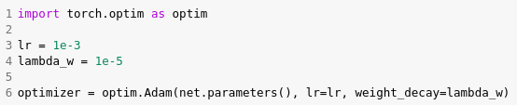
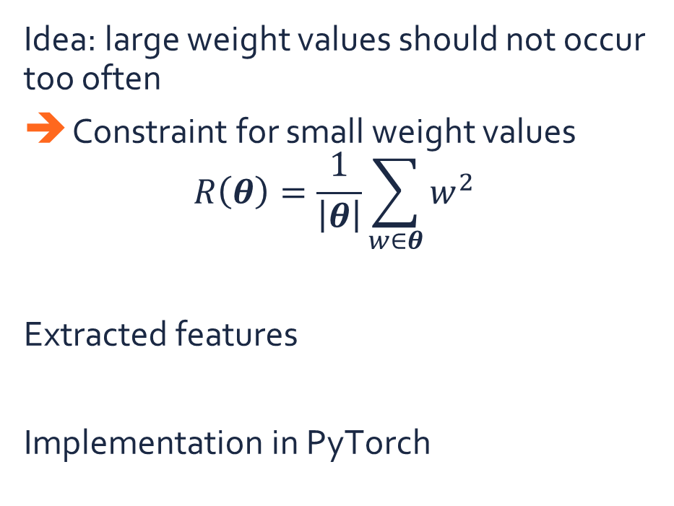
Weight decay
Features “vanilla” autoencoder
Idea: large weight values should not occur too often
Constraint for small weight values
$$R\left(θ\right)=\frac{1}{\left|θ\right|}\sum_{w∈θ}{w^{2}}$$
Extracted features
Implementation in PyTorch
Features autoencoder with weight decay

Slide 22

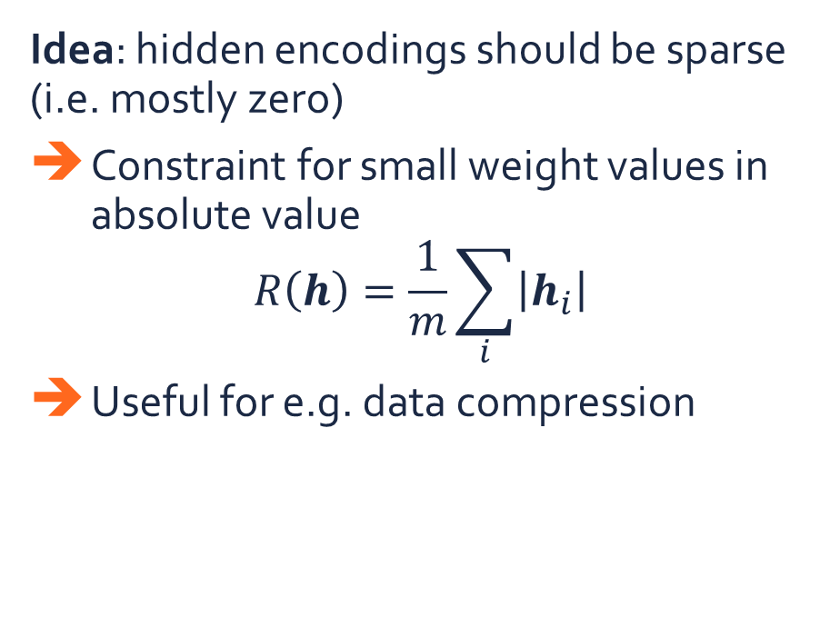
Sparse autoencoders
Idea: hidden encodings should be sparse (i.e. mostly zero)
Constraint for small weight values in absolute value
$$R\left(h\right)=\frac{1}{m}\sum_{i}{\left|h_{i}\right|}$$
Useful for e.g. data compression
$x_{1}$
${\hat{x}}_{1}$
$h_{1}$
$x_{2}$
${\hat{x}}_{2}$
$h_{2}$
$$…$$
$$…$$
$$…$$
$h_{m}$
$x_{n}$
${\hat{x}}_{n}$

Slide 23
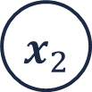



Denoising autoencoder
Idea: reconstruction should be robust to noise
Inject noise at the input stage
Goal: reconstruct the noise-free image
Useful for e.g. data restoration
$x_{1}$
$x_{1}$
${\hat{x}}_{1}$
$h_{1}$
$x_{2}$
$0$
${\hat{x}}_{2}$
$h_{2}$
$$…$$
$$…$$
$$…$$
$$…$$
$h_{m}$
$x_{n}$
$x_{n}$
${\hat{x}}_{n}$

Slide 24

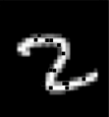


Denoising autoencoder
$$x′$$
$$x$$

Slide 25
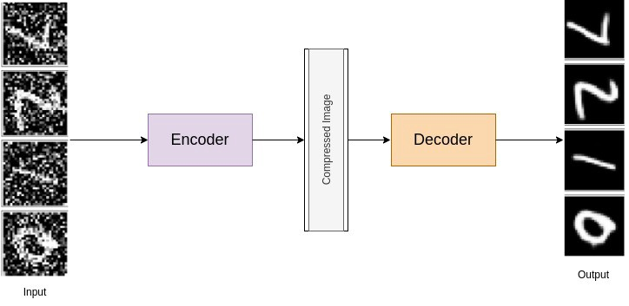
Denoising autoencoder

Slide 26
Deep K-means clustering

Slide 27
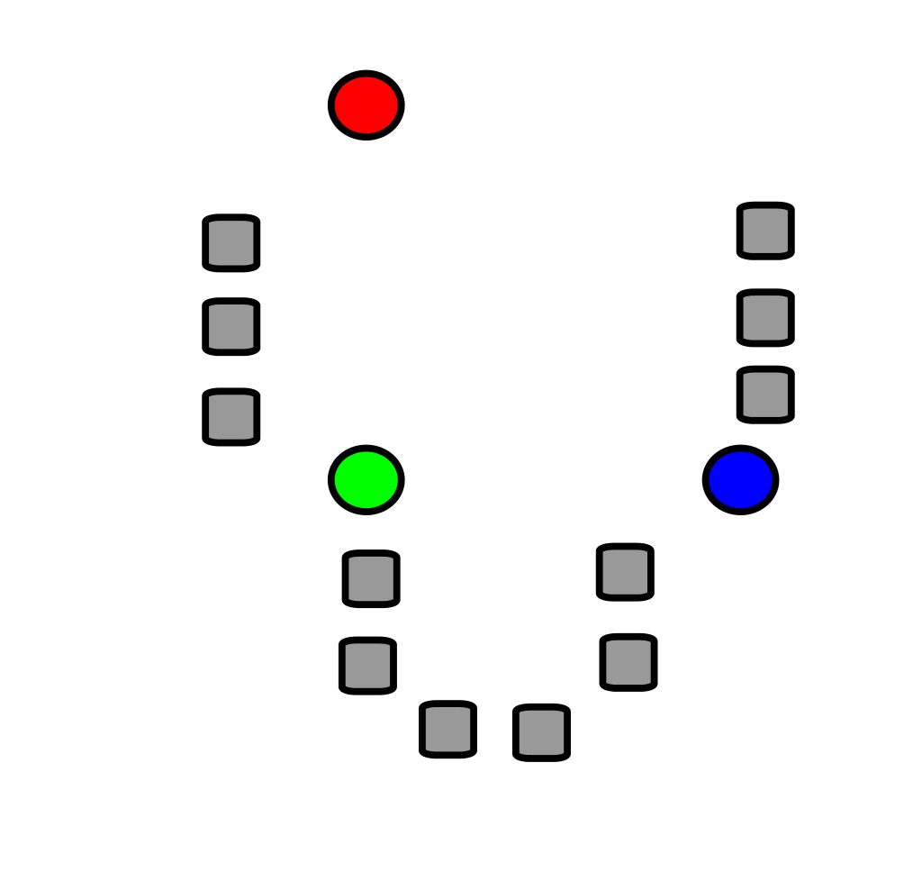
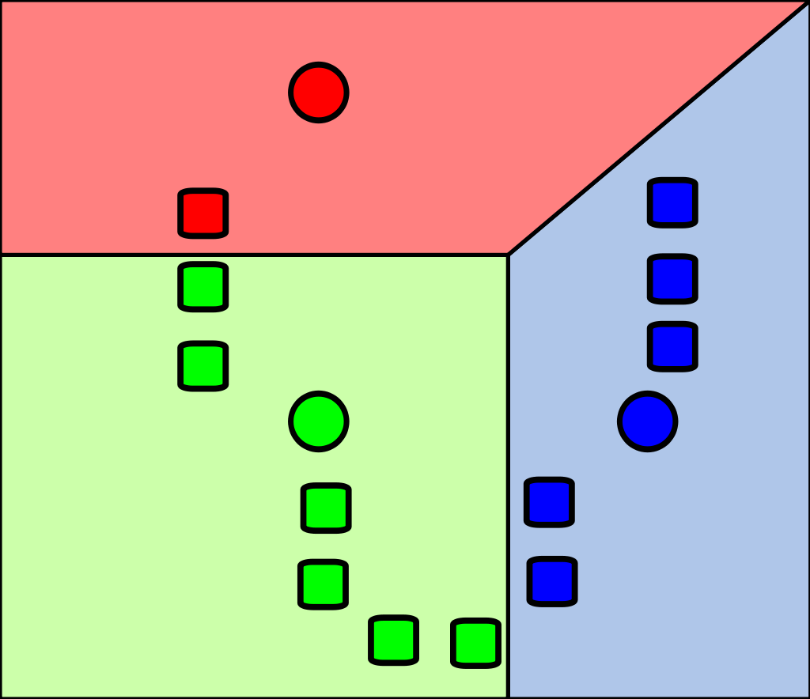
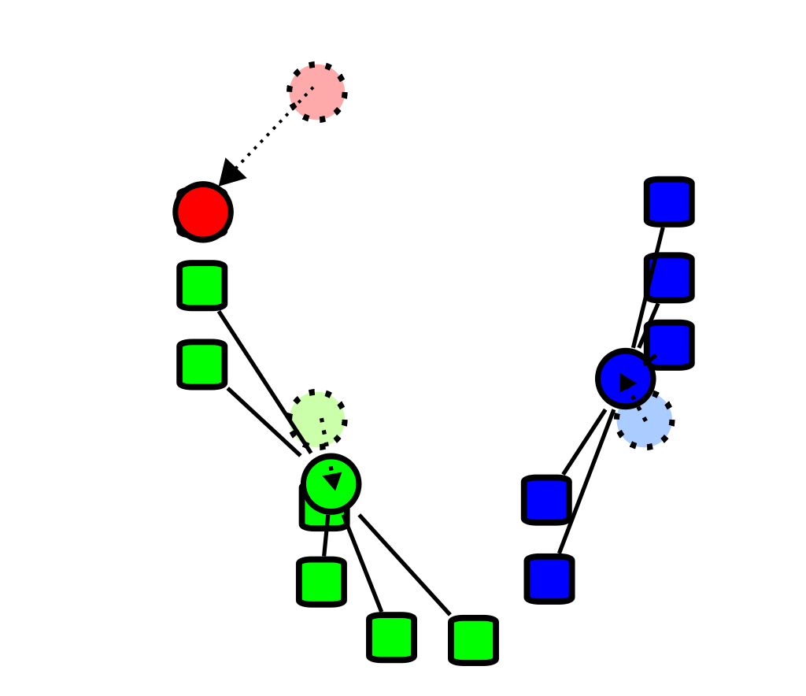
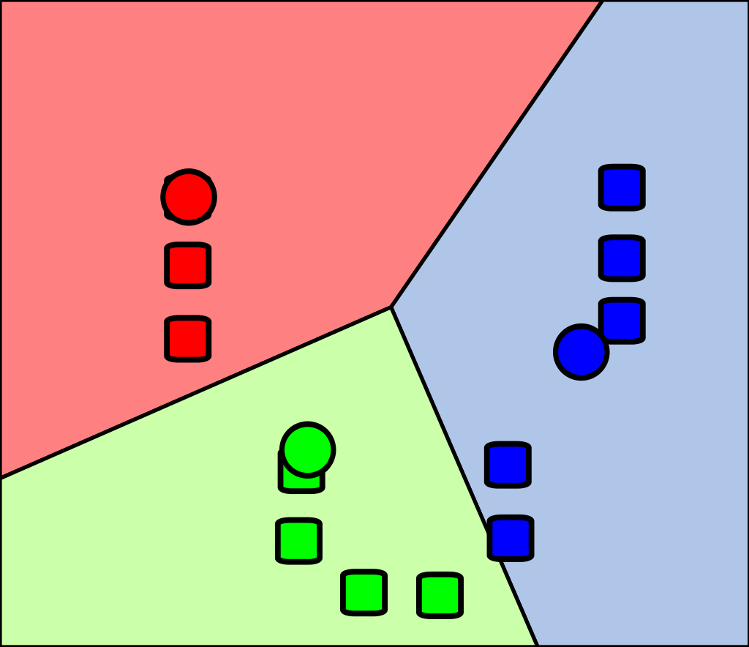
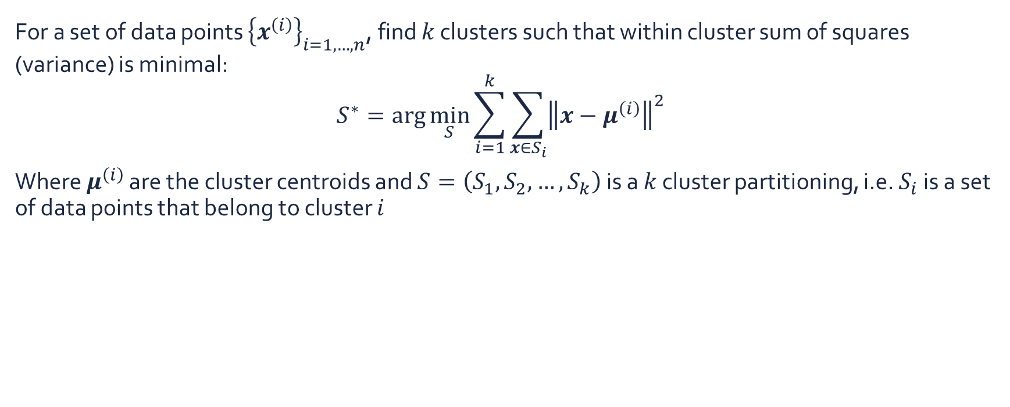
K-means clustering
For a set of data points ${\left\{x^{\left(i\right)}\right\}}_{i=1,…,n}$, find $k$ clusters such that within cluster sum of squares (variance) is minimal:
$$S^{∗}=\arg{\min_{S}{\sum_{i=1}^{k}{\sum_{x∈S_{i}}{{\left\|x−μ^{\left(i\right)}\right\|}^{2}}}}}$$
Where $μ^{\left(i\right)}$ are the cluster centroids and $S=\left(S_{1},S_{2},…,S_{k}\right)$ is a $k$ cluster partitioning, i.e. $S_{i}$ is a set of data points that belong to cluster $i$
Initialize centroids
Assign cluster labels
Update centroids
Assign cluster labels
…

Slide 28
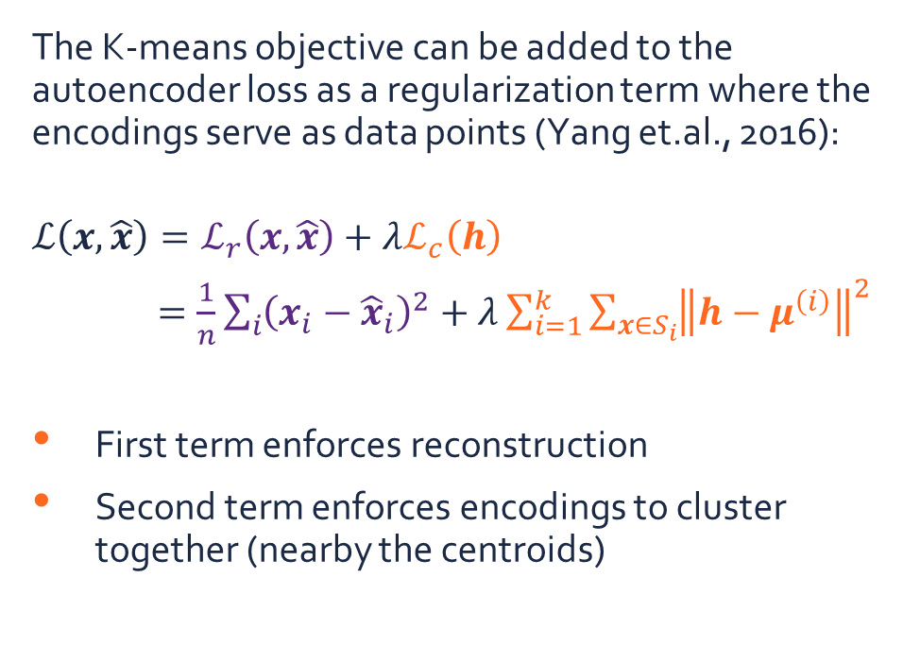
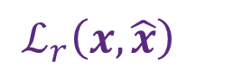
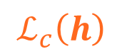
K-means clustering regularization
The K-means objective can be added to the autoencoder loss as a regularization term where the encodings serve as data points (Yang et.al., 2016):
$$ℒ\left(x,\hat{x}\right)=ℒ_{r}\left(x,\hat{x}\right)+λℒ_{c}\left(h\right)$$
$=\frac{1}{n}\sum_{i}{{\left(x_{i}−{\hat{x}}_{i}\right)}^{2}}+λ\sum_{i=1}^{k}{\sum_{x∈S_{i}}{{\left\|h−μ^{\left(i\right)}\right\|}^{2}}}$
First term enforces reconstruction
Second term enforces encodings to cluster together (nearby the centroids)
$x_{1}$
${\hat{x}}_{1}$
$h_{1}$
$x_{2}$
${\hat{x}}_{2}$
$h_{2}$
$$…$$
$$…$$
$$…$$
$h_{m}$
$x_{n}$
${\hat{x}}_{n}$
$$ℒ_{c}\left(h\right)$$
$$ℒ_{r}\left(x,\hat{x}\right)$$

Slide 29
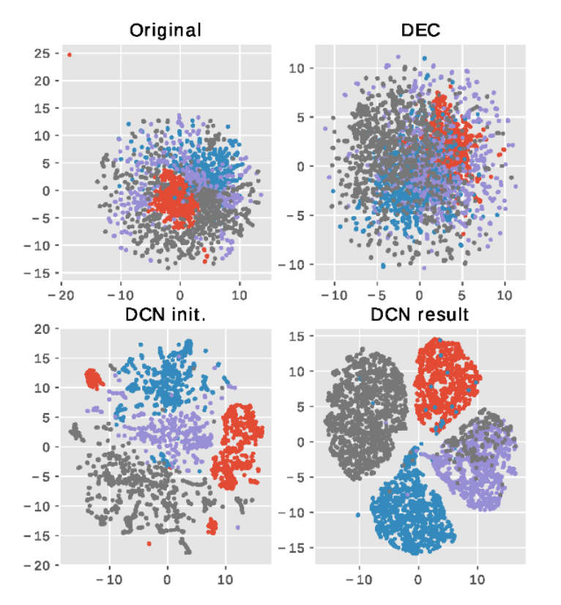
Deep clustering networks
Clustering results on RCV1-v2 dataset
Deep clustering networks (DCN) are able to map the inputs to lower-dimensional embeddings that are densely clustered

Slide 30
Summary
Unsupervised neural networks: (stacked) autoencoders
Reconstruct the input
Additional regularization can improve feature extraction:
Weight decay
Sparsity
Denoising autoencoders
Additional regularization can also improve clustering:
K-means loss
Deep clustering networks
$x_{1}$
${\hat{x}}_{1}$
$h_{1}$
$x_{2}$
${\hat{x}}_{2}$
$h_{2}$
$$…$$
$$…$$
$$…$$
$h_{m}$
$x_{n}$
${\hat{x}}_{n}$

Slide 31
Exercises

Slide 32
Exercises
Open the notebook in Google Colab:
https://colab.research.google.com/github/JorisRoels/deep-learning-biology/blob/main/exercises/assignments/dlb-5-unsupervised-neural-networks.ipynb
Make sure you are using a GPU: Runtime > Change Runtime Type > Select ‘GPU’
Move to your break-out room
Ask questions to the assistants in the break-out room!

Slide 34
References
Lee, H., Grosse, R., Ranganath, R., & Ng, A. Y. (2011). Unsupervised learning of hierarchical representations with convolutional deep belief networks. Communications of the ACM. https://doi.org/10.1145/2001269.2001295
Yang, B., Fu, X., Sidiropoulos, N. D., & Hong, M. (2016). Towards K-means-friendly Spaces: Simultaneous Deep Learning and Clustering. International Conference on Machine Learning, 8, 5888–5901. http://arxiv.org/abs/1610.04794

